Slide 1
Finite State Verification System
Jose A. Lopez
Formal Methods
Professor: Rodion Podorozhny
Spring 2012

Slide 2
Usability
The system is console based: the inputs are folders containing the test cases and are passed to the system trough the console.
The output is generated by the system and displayed in the console.

Slide 3
Inputs
The system takes as inputs, 2 files; a file that contains the Kripke structure (with extension .kpk) and one that contains the state and the formula to be verified by the system(with extension ctl).
The structure to be followed by the firs file is:
W={};R={};L()={};
W={s1,s2,s3…,sn}
  this denotes the states to be created by the system

Slide 4
R={(s1,s2),(s2,s3)…,(sn,sk)}
  This notation describes the relations between the states in the model, here we se pairs encased by “()”, separated by “,” and everithing encased by “{}”. The order of the elements of the pair describes the orientation of the relation, being the first, the element from where the relation originates, and the second one, the target of the first element;

Slide 5
L(s0)={a,b,c…},L(s1)={a,b,c..}…L(sn)={a,b,c}
  Finally we have the values held by the states, where L(s0) denotes the state we want to label and {a,b,c…} the values we want to label that state with.
  Again everything separated by comas

Slide 6
Restrictions
The names of the states have to be lower case and can include numbers.
The labels(values) for the states have to be lowercase and cannot include numbers.
The reserved symbods: W,R, and L have to be upper case.
Each section has to end with “;”

Slide 7
Input
The second input file has the structure sn; F;
  Where sn represents the state to be verified by the system and F the formula, and at the end of both a “;”.
  Reserved symbols: and|^, or, not , AG(F), EG(F), AF(F), EF(F), AX(F),EX(f),E[FUF],A[FUF].
  The grammar for the formulas is as follows:
    F = void | p | F and F | (F) and (F) | F or F | (F) or (F) | not F | not (F) | AG(F) | EG(F) | AF(F) | EF(F) | AX(F) | EX(F) | A[ F U F ] | E[F U F]
  The CTL connectives have to be uppercase while Boolean connectives can be either lowercase or uppercase.

Slide 8
Input
The system does allow nested formulas by example:
  AX(E[F U F])
And boolean opperations between them or other objects:
  AG(F) and E[F U F]
  EX(F) and r

Slide 9
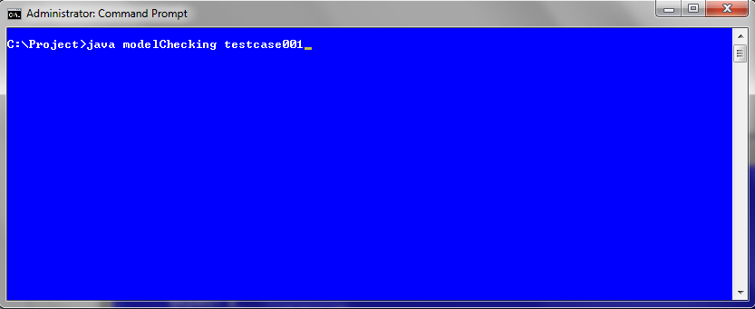
Execution
Just call the java executable with the name of the main class “modelChecking” and the name of the folder containing the files to be checked:

Slide 10
Execution
There must be 2 files on the folder, kripke.kpk containing the model to evaluate and test.ctl, that describes the formula.

Slide 11
Output
The output will be generated by the system and displayed in the console with the following structure:
s1 (holds: | does not hold:) F
F
State s1:
  Values:
  Relations:
  Holds:

Slide 12
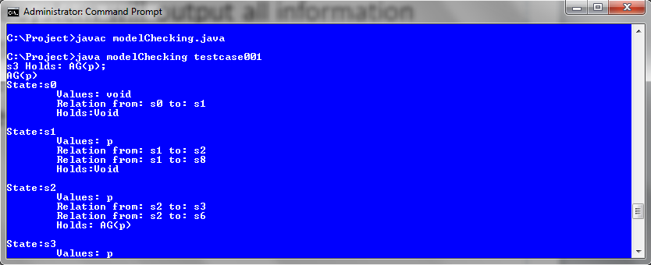
Output
The system will output all information regarding the system in the console, including the formulas, whether or not they hold and if the files or folders specified do not exists.

Slide 13
Test Cases Included

Slide 14
Test Cases – testcase001
s0
r
Model
W={s0,s1,s2,s3};
R={(s0,s1),(s0,s3),(s0,s0),(s1,s2),(s2,s1),(s3,s2)};
L(s0)={r},L(s1)={p,t,r},L(s2)={q,r},L(s3)={p,q};
s1
s2
p,t,r
q,r
Formula:
s3; AG(EF(p));
p,q
s3

Slide 15
Test Cases – testcase002
Model:
W={s0,s1,s2,s3,s4,s5,s6,s7,s8,s9};
R={(s0,s1),(s1,s2),(s2,s3),(s3,s4),(s4,s5),(s5,s4),(s5,s3),(s2,s6),(s6,s7),(s7,s6),(s1,s8),(s8,s9),(s9,s8)};
L(s0)={void},L(s1)={p},L(s2)={p},L(s3)={p},L(s4)={p},L(s5)={p},L(s6)={p},L(s7)={p},L(s8)={p},L(s9)={void};
s0
s1
p
AG p
s8
p
p
s2
AG p
s3
p
p
AG p
Formula:
s3; AG(p);
s9
s6
s5
s4
s7
p
p
p
AG p
AG p
AG p

Slide 16
Test Case-testcase003
x2
Model:
W={x1,x2,x3,x4,x5,x6};
R={(x1,x2),(x1,x3),(x2,x2),(x2,x3),(x3,x2),(x4,x5),(x5,x4),(x5,x6)};
L(x1)={q},L(x2)={p,q},L(x3)={p},L(x4)={q},L(x5)={void},L(x6)={p};
p
p
Formula:
x1; A[pUq];
x3
x1
p
x6
p
x4
x5

